Slide 1

Optimized Learning with Virtual Reality Summer 2020
Codey Winslow
Dr. Philip Howard

Slide 2
Goal of the Project
Can VR teach industry skills?
Is it a cheap alternative to mocking expensive setups?

Slide 3
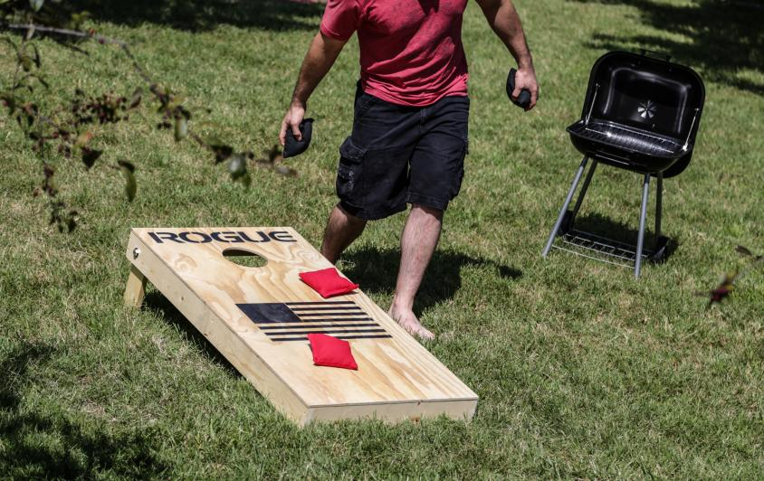
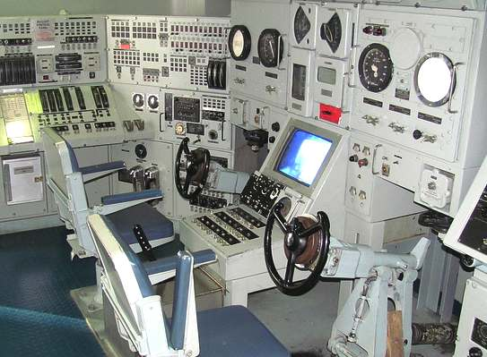
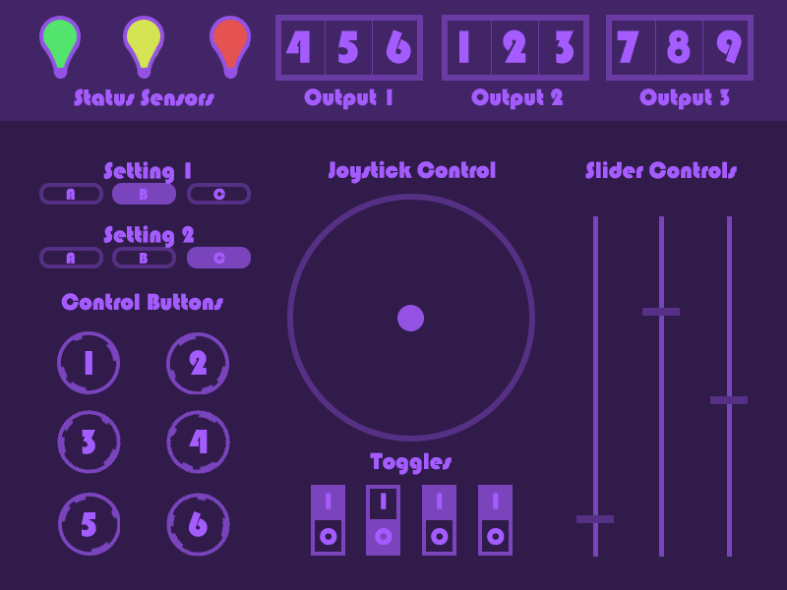
Plans for Execution
Initial
Cornhole
Procedure
Final
Touchscreen
3 Procedures
Simple
Intermediate
Advanced
2020 | Optimized Learning with Virtual Reality | Codey Winslow

Slide 4
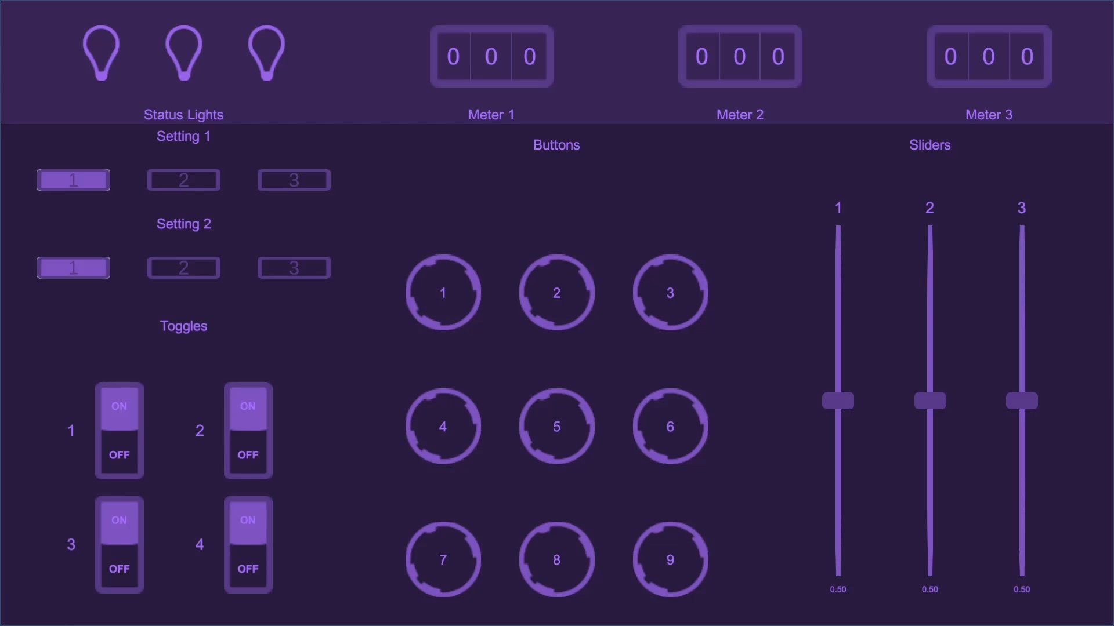
Procedures
Level 1 – Rote Memorization
1. Press button 1
2. Switch toggle 4
2020 | Optimized Learning with Virtual Reality | Codey Winslow

Slide 5
Procedures
Level 2 – Enumerated Rote Memorization
Green light
= sequence 1
Yellow light
= sequence 2
Red light
= sequence 3
2020 | Optimized Learning with Virtual Reality | Codey Winslow

Slide 6
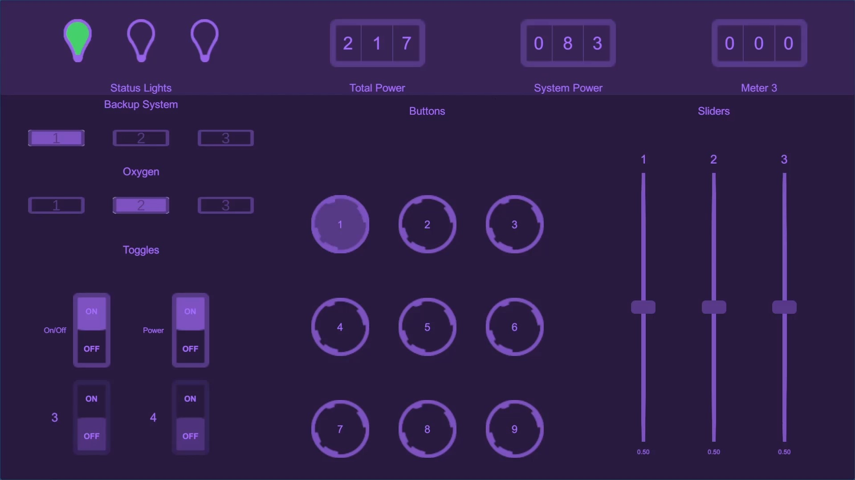
Procedures
Remaining Power
Level 3 – Skill and Judgement
Required Power
System group
View system
Turn on/off
2020 | Optimized Learning with Virtual Reality | Codey Winslow

Slide 7
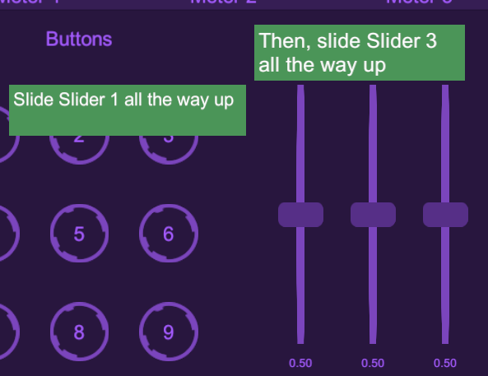
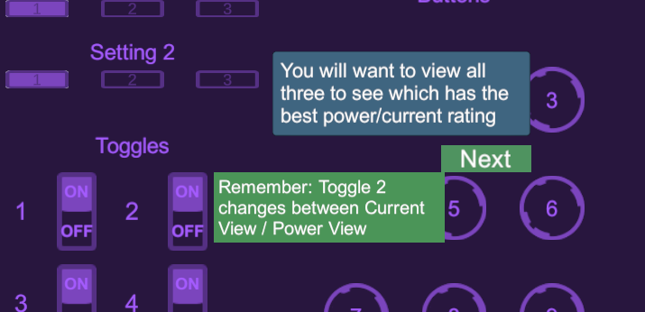
Building the UI – Tutorials
Hints for what to do next
Next buttons to move on

Slide 8

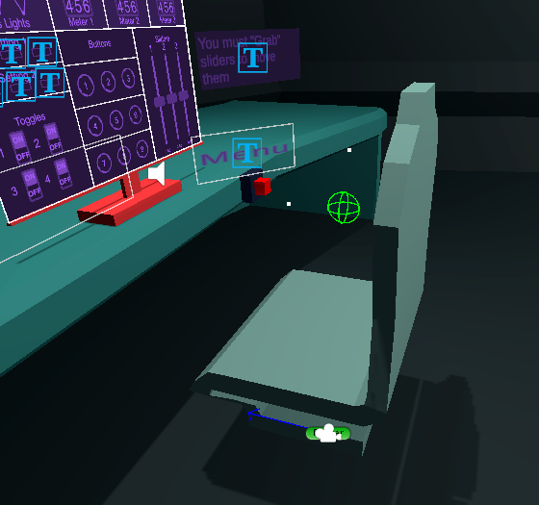
Implementing VR Behavior

Slide 9
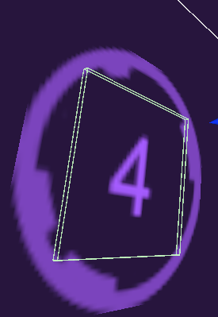
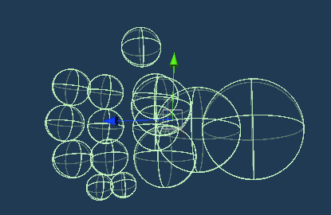
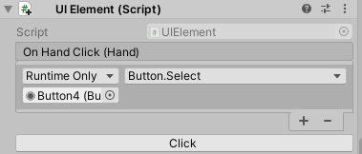
Implementing VR Behavior - Touchscreen
Touchscreen Button Collider
Hand colliders
TODO: SHOW UI IN VR
Component captures hand collision

Slide 10
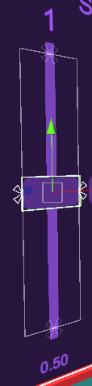
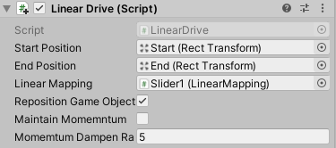
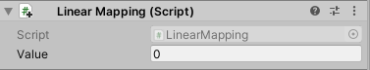
Implementing VR Behavior - Sliders
end
Updates value of component
start

Slide 11
Testing
TODO: Show tutorials

Slide 12

Testing

Slide 13
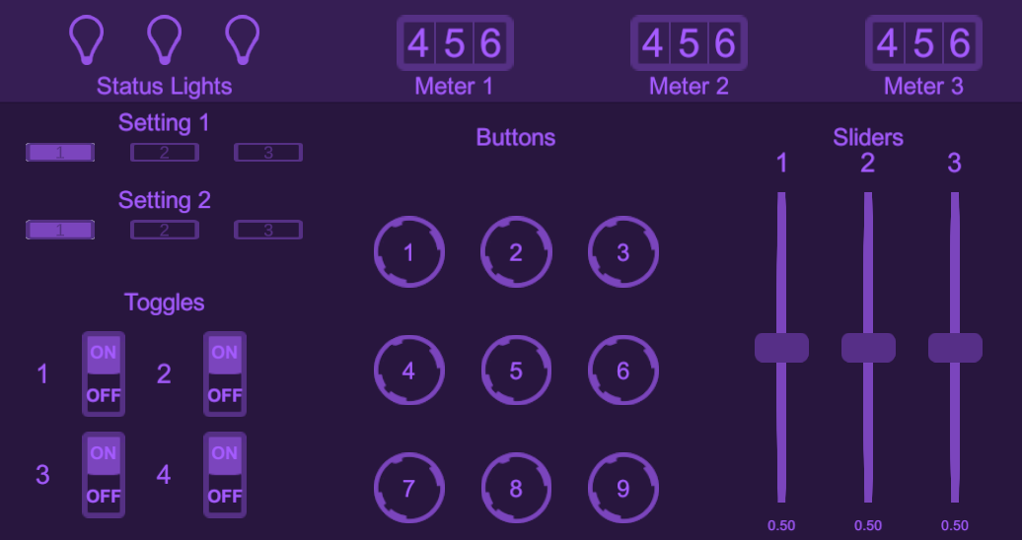
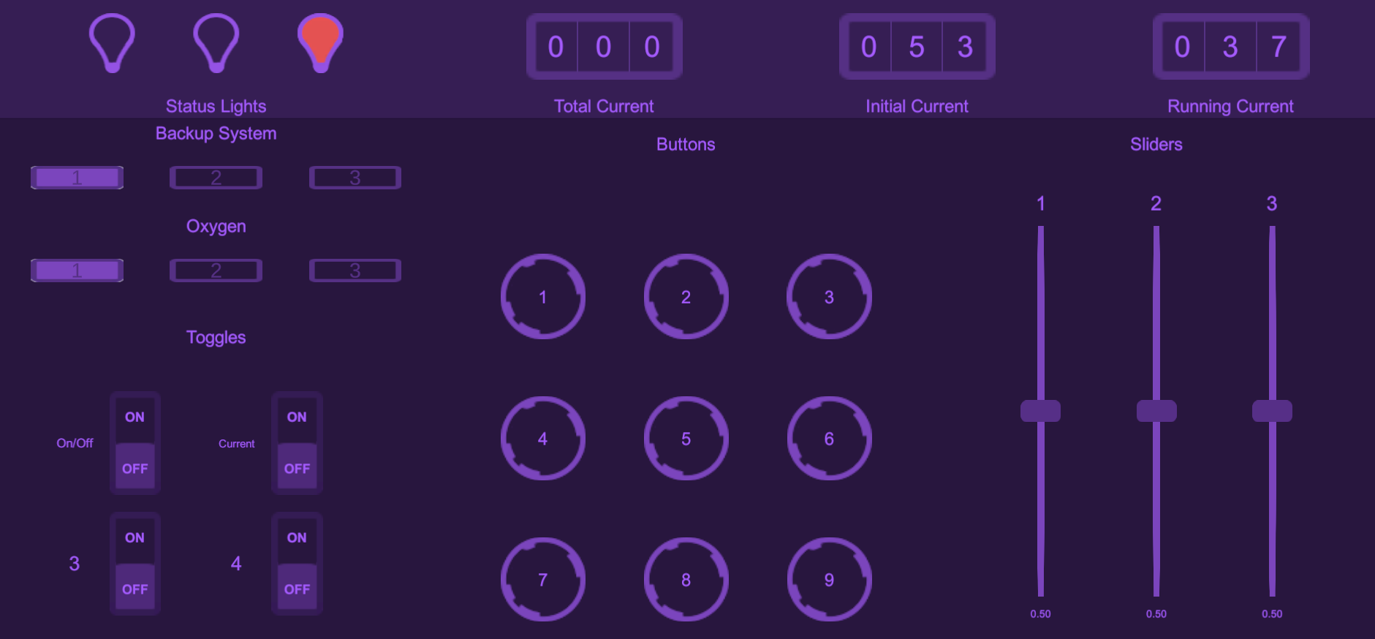
Testing
Not descriptive
More helpful

Slide 14
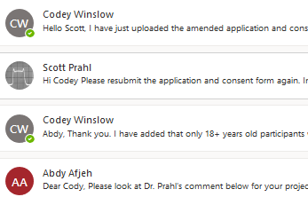
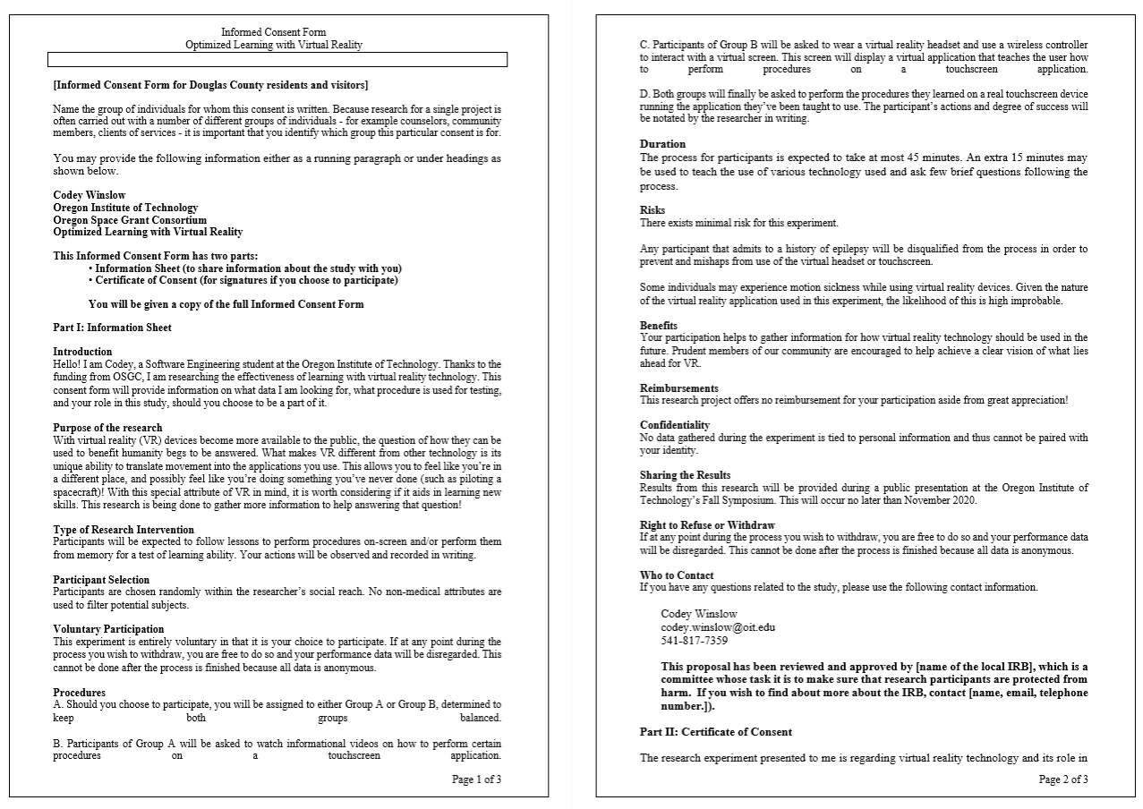
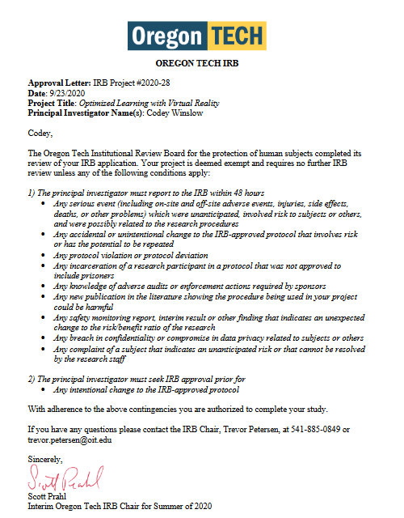
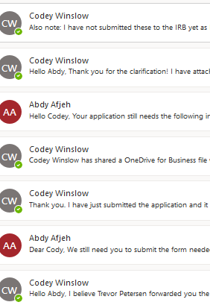
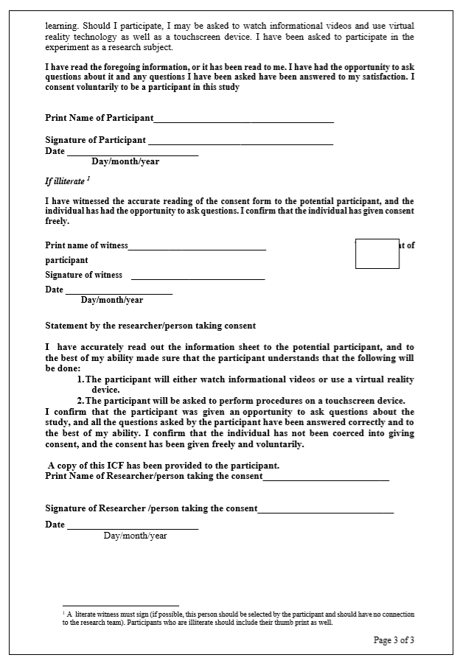
Human Subject Approval
2 weeks of emailing
Informed Consent Form
Approval/Exempt

Slide 15
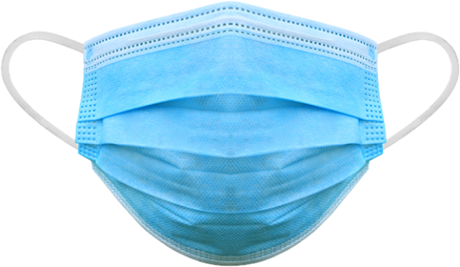
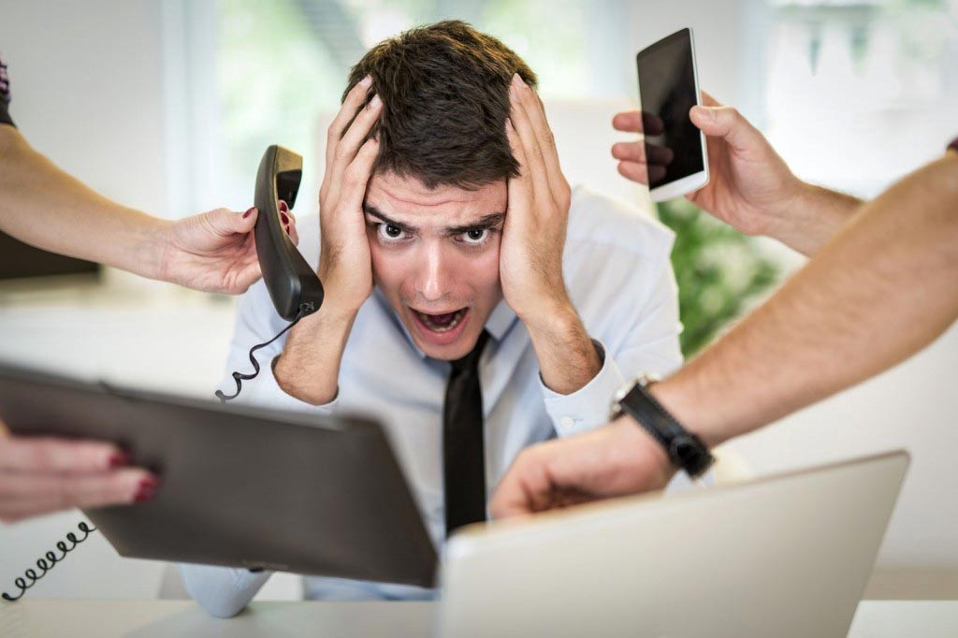

Worthwhile Experience
Deal with distractions
Build focusing skills

Slide 16
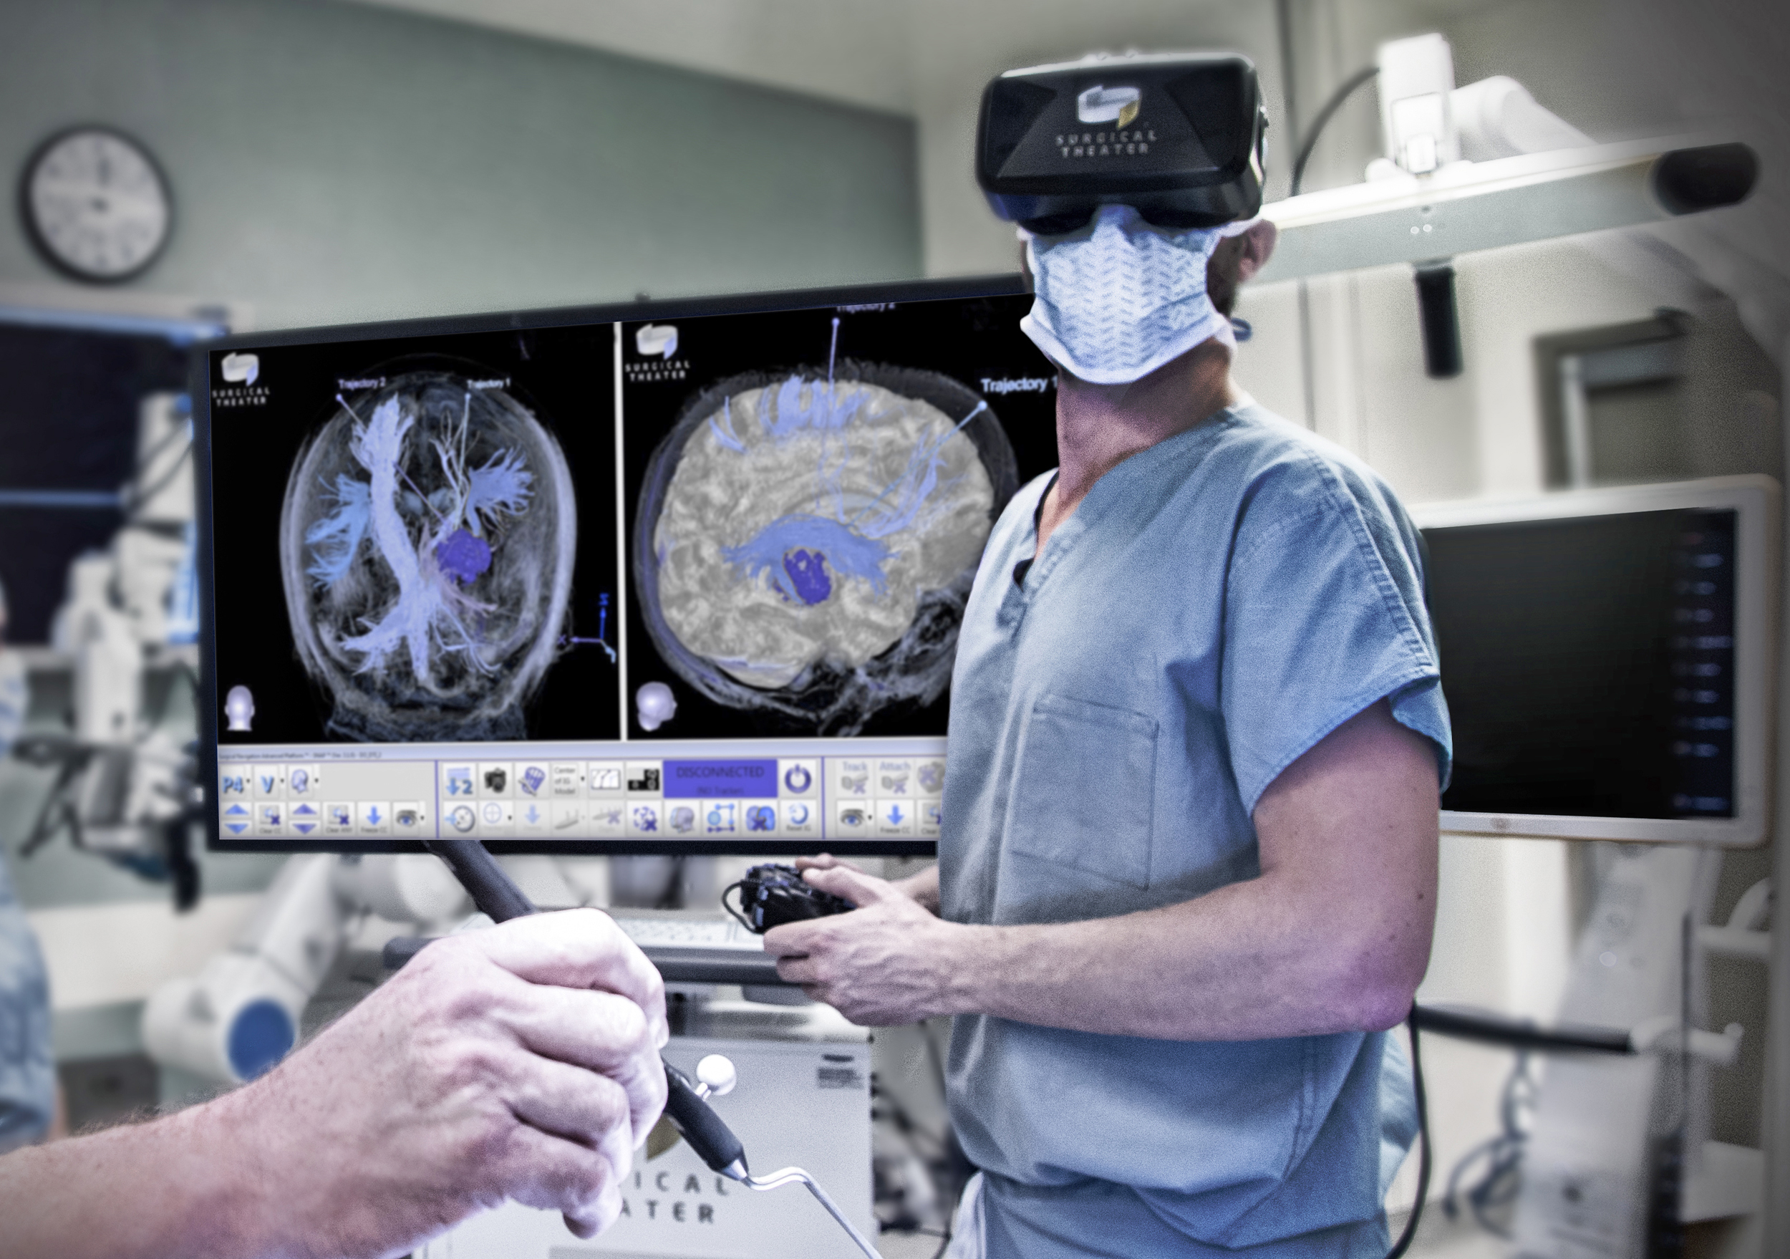

What Lies Ahead
Can physical skills be learned better in VR?
What other potentials does VR technology hold?

Slide 17
Thanks for coming!
Questions?
Contact me at codey.winslow@oit.edu

